Slide 1
Earth’s Closing Events
Lesson 12, 2nd Quarter 2024

Slide 2
A storm is coming, relentless in its fury. Are we prepared to meet it?
Testimonies for the Church, vol, 8, p. 315
Ellen G. White

Slide 3
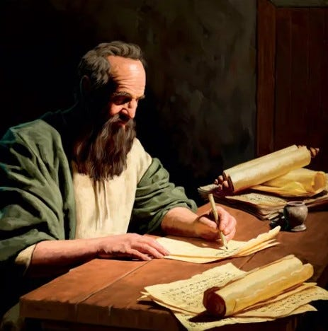
The Roadmap: 2 Peter 1:1-21
1 Simon Peter, a servant and an apostle of Jesus Christ, to them that have obtained like precious faith with us through the righteousness of God and our Saviour Jesus Christ:

Slide 4
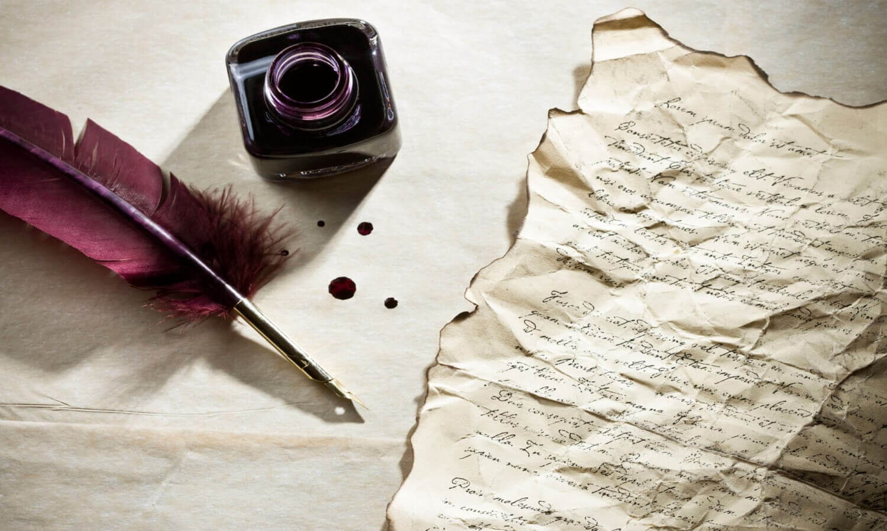
The Roadmap: 2 Peter 1:2-21
2 Grace and peace be multiplied unto you through the knowledge of God, and of Jesus our Lord,

Slide 5
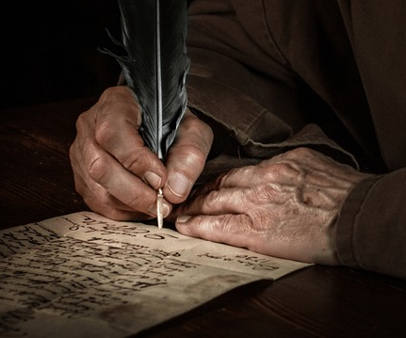
The Roadmap: 2 Peter 1:3-21
3 According as his divine power hath given unto us all things that pertain unto life and godliness, through the knowledge of him that hath called us to glory and virtue:

Slide 6
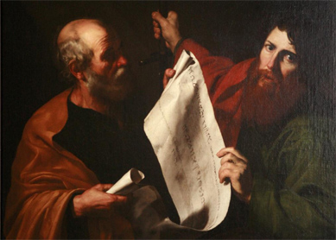
The Roadmap: 2 Peter 1:4-21
4 Whereby are given unto us exceeding great and precious promises: that by these ye might be partakers of the divine nature, having escaped the corruption that is in the world through lust.

Slide 7

The Roadmap: 2 Peter 1:5-21
5 And beside this, giving all diligence, add to your faith virtue; and to virtue knowledge;

Slide 8
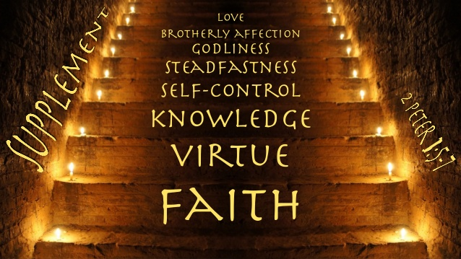
The Roadmap: 2 Peter 1:6-21
6 And to knowledge temperance; and to temperance patience; and to patience godliness;

Slide 9
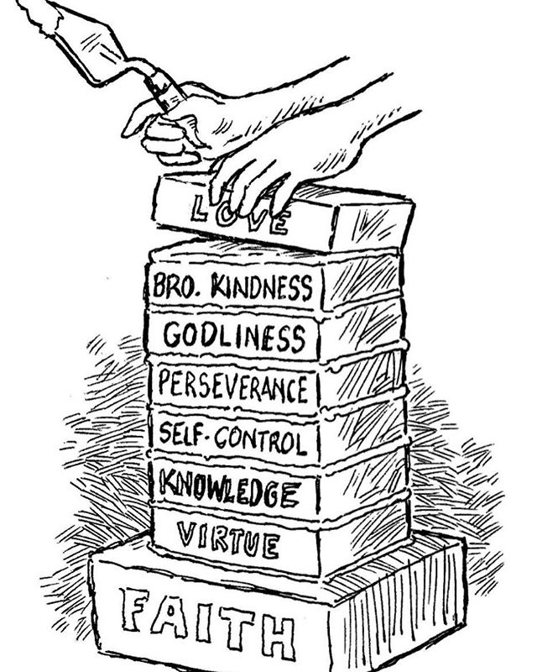
The Roadmap: 2 Peter 1:7-21
7 And to godliness brotherly kindness; and to brotherly kindness charity.

Slide 10

The Roadmap: 2 Peter 1:8-21
8 For if these things be in you, and abound, they make you that ye shall neither be barren nor unfruitful in the knowledge of our Lord Jesus Christ.

Slide 11
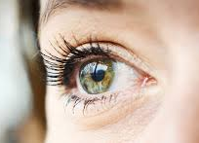
The Roadmap: 2 Peter 1:9-21
9 But he that lacketh these things is blind, and cannot see afar off, and hath forgotten that he was purged from his old sins.

Slide 12

The Roadmap: 2 Peter 1:10-21
10 Wherefore the rather, brethren, give diligence to make your calling and election sure: for if ye do these things, ye shall never fall:

Slide 13
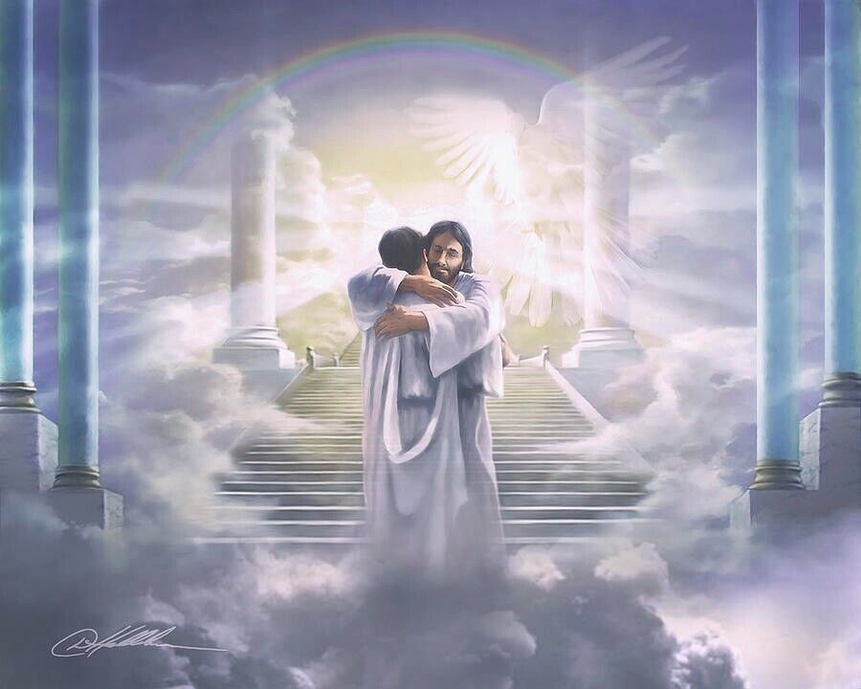
The Roadmap: 2 Peter 1:11-21
11 For so an entrance shall be ministered unto you abundantly into the everlasting kingdom of our Lord and Saviour Jesus Christ.

Slide 14
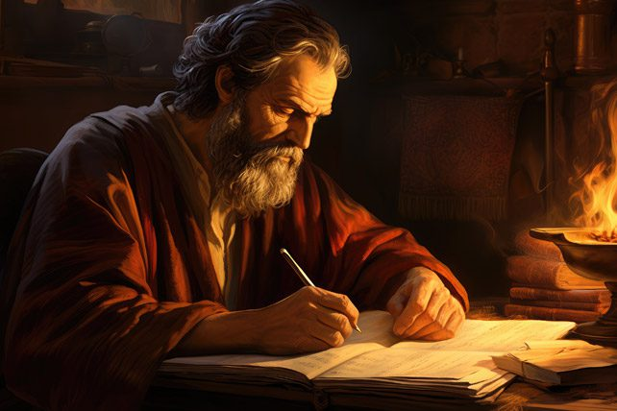
The Roadmap: 2 Peter 1:12-21
12 Wherefore I will not be negligent to put you always in remembrance of these things, though ye know them, and be established in the present truth.

Slide 15
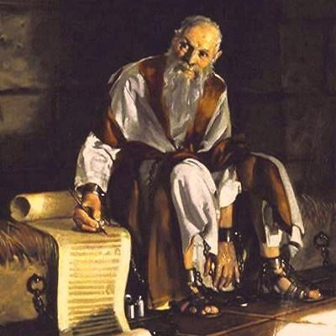
The Roadmap: 2 Peter 1:13-21
13 Yea, I think it meet, as long as I am in this tabernacle, to stir you up by putting you in remembrance;

Slide 16
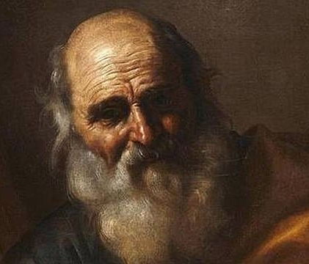
The Roadmap: 2 Peter 1:14-21
14 Knowing that shortly I must put off this my tabernacle, even as our Lord Jesus Christ hath shewed me.

Slide 17
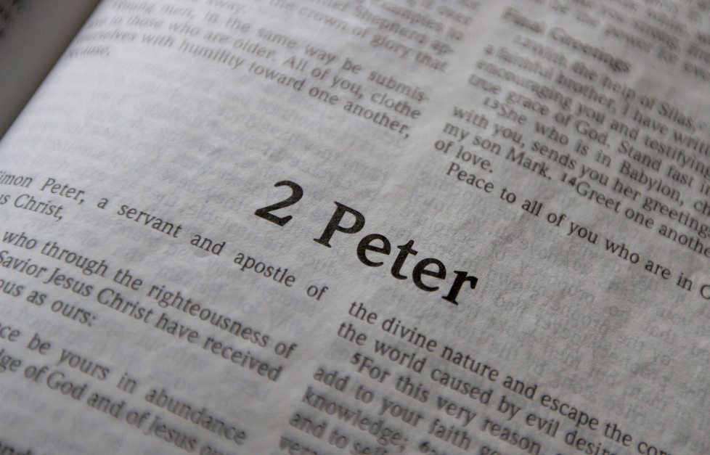
The Roadmap: 2 Peter 1:15-21
15 Moreover I will endeavour that ye may be able after my decease to have these things always in remembrance.

Slide 18
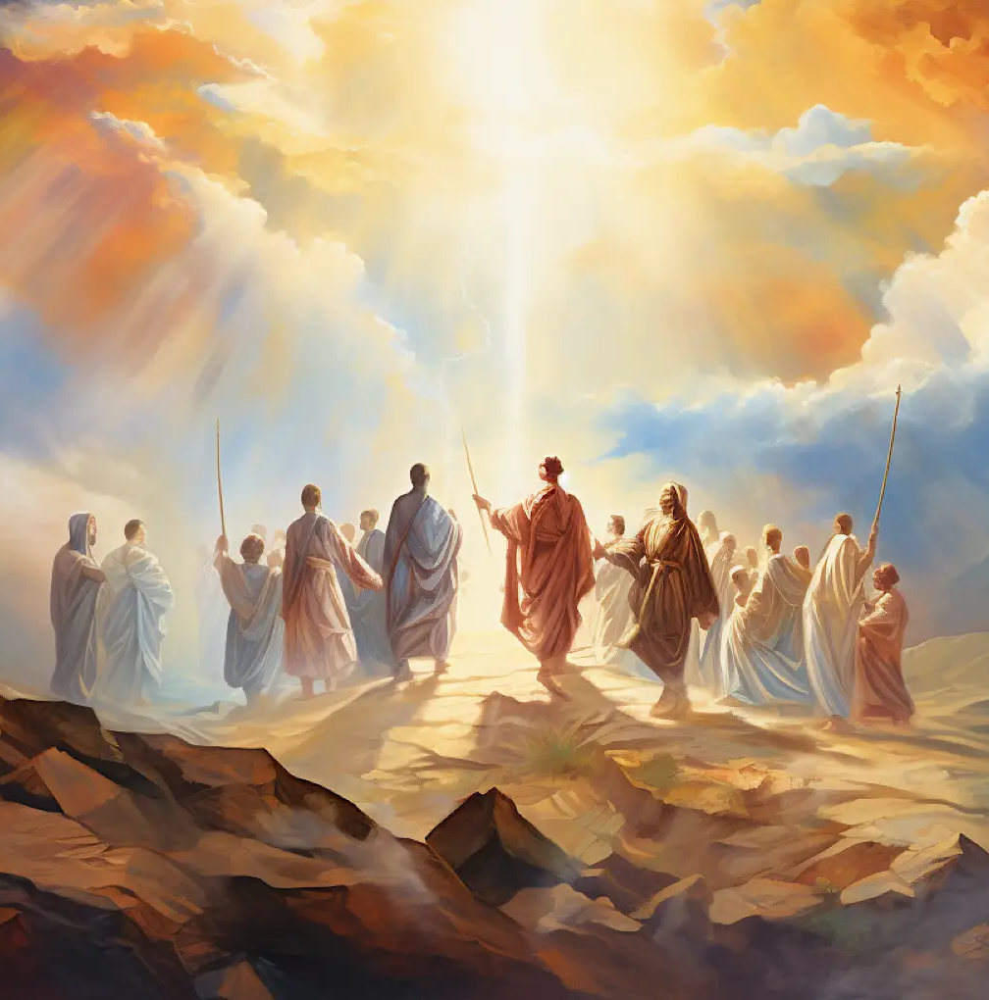
The Roadmap: 2 Peter 1:16-21
16 For we have not followed cunningly devised fables, when we made known unto you the power and coming of our Lord Jesus Christ, but were eyewitnesses of his majesty.

Slide 19
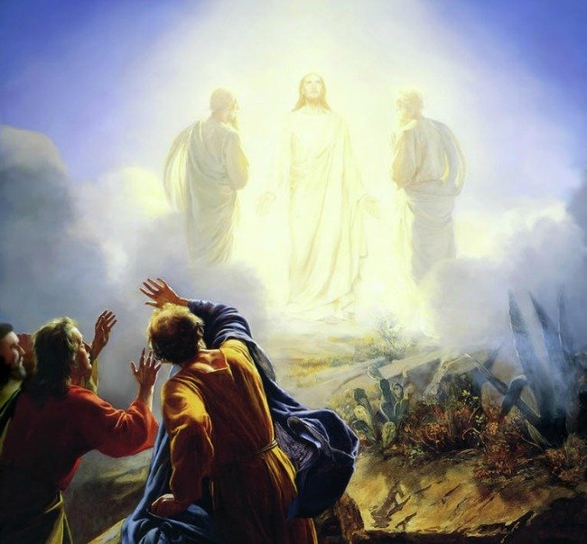
The Roadmap: 2 Peter 1:17-21
17 For he received from God the Father honour and glory, when there came such a voice to him from the excellent glory, This is my beloved Son, in whom I am well pleased.

Slide 20
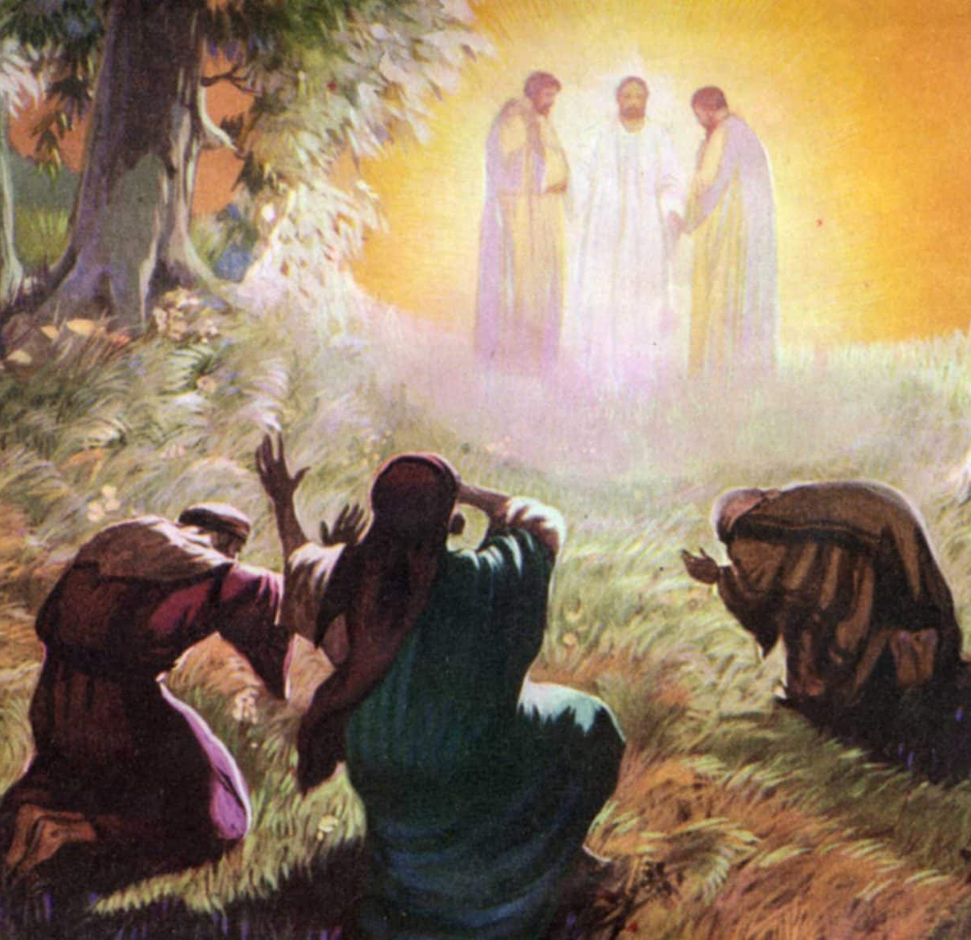
The Roadmap: 2 Peter 1:18-21
18 And this voice which came from heaven we heard, when we were with him in the holy mount.

Slide 21
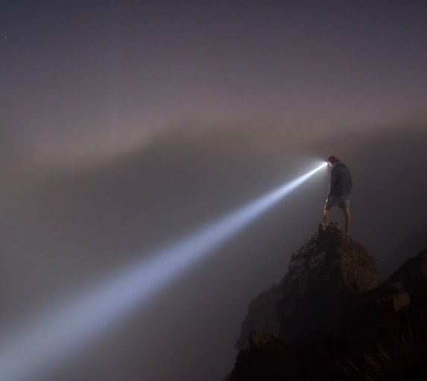
The Roadmap: 2 Peter 1:19-21
19 We have also a more sure word of prophecy; whereunto ye do well that ye take heed, as unto a light that shineth in a dark place, until the day dawn, and the day star arise in your hearts:

Slide 22

The Roadmap: 2 Peter 1:20-21
20 Knowing this first, that no prophecy of the scripture is of any private interpretation.

Slide 23
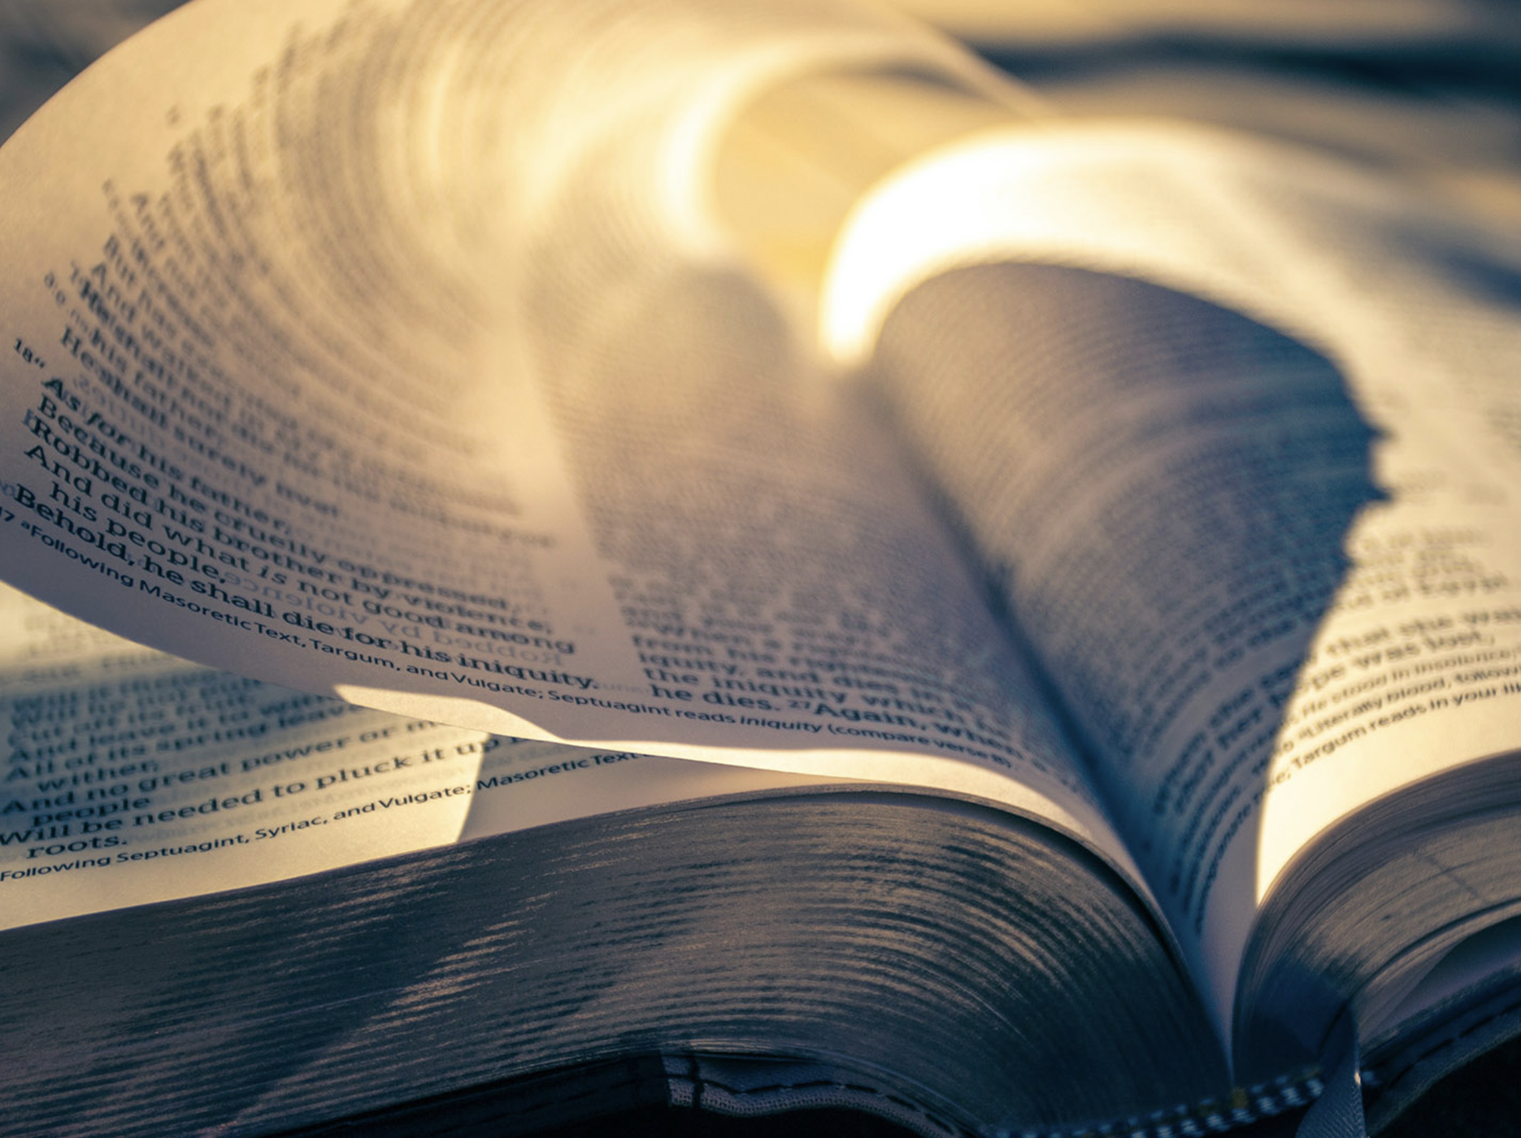
The Roadmap: 2 Peter 1:21
21 For the prophecy came not in old time by the will of man: but holy men of God spake as they were moved by the Holy Ghost.

Slide 24
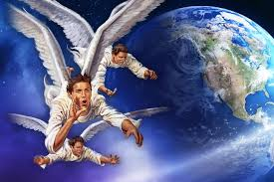
The WARNING: Revelation 14:6-12
6 And I saw another angel fly in the midst of heaven, having the everlasting gospel to preach unto them that dwell on the earth, and to every nation, and kindred, and tongue, and people,

Slide 25
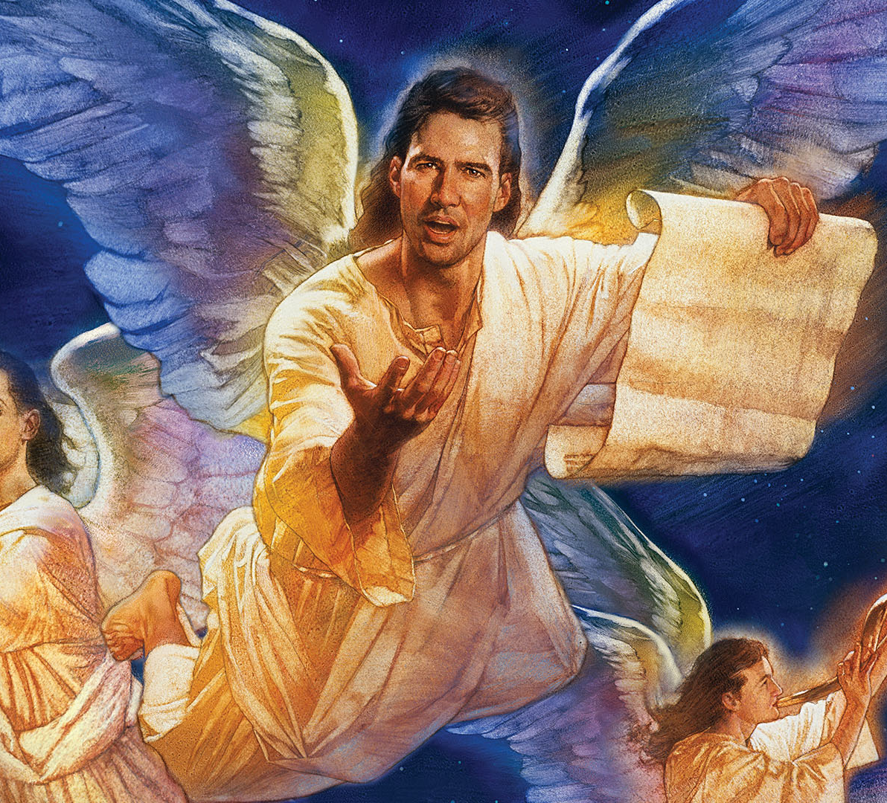
The WARNING: Revelation 14:7-12
7 Saying with a loud voice, Fear God, and give glory to him; for the hour of his judgment is come: and worship him that made heaven, and earth, and the sea, and the fountains of waters.

Slide 26
The WARNING: Revelation 14:7-12
The worship of God is in contrast with the worship of the beast and that of its image.
In the crisis soon to come, the inhabitants of the earth will be called to make their choice.
The message of the first angel is designed to prepare men to make the proper choice and to stand firm in the time of crisis.
7 Saying with a loud voice, Fear God, and give glory to him; for the hour of his judgment is come: and worship him that made heaven, and earth, and the sea, and the fountains of waters.

Slide 27
The WARNING: Revelation 14:7-12
The Creator of the universe is the true and only object of worship. No man, no angel, is worthy of worship. This is the prerogative of God only.
The call to worship the God of heaven as Creator of all things implies that due heed be given to the sign of God’s creative works — the Sabbath of the Lord.
The Sabbath will be a point especially controverted in the closing crisis.
7 Saying with a loud voice, Fear God, and give glory to him; for the hour of his judgment is come: and worship him that made heaven, and earth, and the sea, and the fountains of waters.

Slide 28
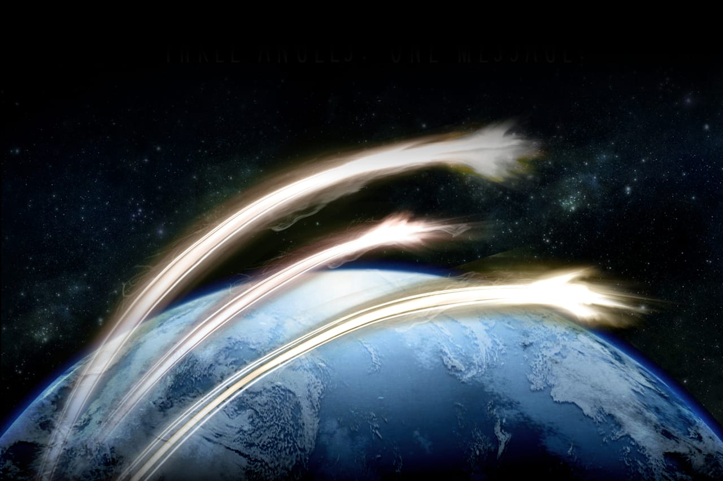
The WARNING: Revelation 14:8-12
8 And there followed another angel, saying, Babylon is fallen, is fallen, that great city, because she made all nations drink of the wine of the wrath of her fornication.

Slide 29
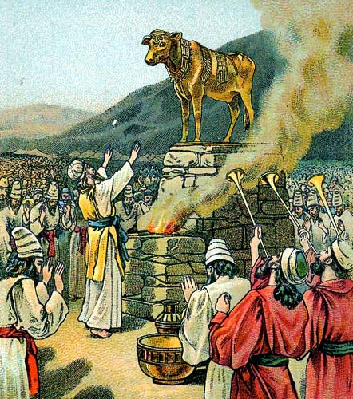
The WARNING: Revelation 14:9-12
9 And the third angel followed them, saying with a loud voice, If any man worship the beast and his image, and receive his mark in his forehead, or in his hand,

Slide 30
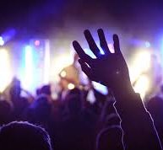
The WARNING: Revelation 14:10-12
10 The same shall drink of the wine of the wrath of God, which is poured out without mixture into the cup of his indignation; and he shall be tormented with fire and brimstone in the presence of the holy angels, and in the presence of the Lamb:

Slide 31
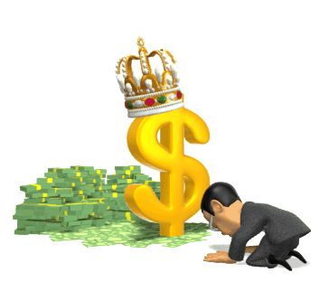
The WARNING: Revelation 14:11-12
11 And the smoke of their torment ascendeth up for ever and ever: and they have no rest day nor night, who worship the beast and his image, and whosoever receiveth the mark of his name.

Slide 32
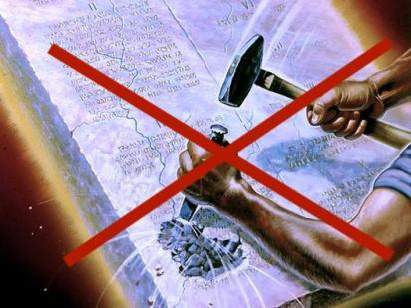
The WARNING: Revelation 14:12
12 Here is the patience of the saints: here are they that keep the commandments of God, and the faith of Jesus.

Slide 33
Israel's Sign: Genesis 17:9-11
⁹ And God said unto Abraham, Thou shalt keep my covenant therefore, thou, and thy seed after thee in their generations.
¹⁰ This is my covenant, which ye shall keep, between me and you and thy seed after thee; Every man child among you shall be circumcised.
¹¹ And ye shall circumcise the flesh of your foreskin; and it shall be a token of the covenant betwixt me and you.

Slide 34
It’s a little graphic as a sign, but it was meant to be! It’s a bloody, graphic message to a very pragmatic desert people. God is to be trusted, even (or maybe especially) over one’s own flesh.
Abraham and Sarah have demonstrated that they’re trusting in the flesh. They have conspired to get a son—Ishmael—through their own fleshly machinations rather than trusting in God and God’s timing. And now, what is God asking them to do? The sign of the covenant becomes a cutting off of the flesh.

Slide 35
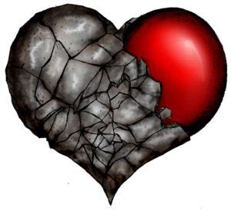
Israel's Sign: Deuteronomy 30:6
⁶ And the Lord thy God will circumcise thine heart, and the heart of thy seed, to love the Lord thy God with all thine heart, and with all thy soul, that thou mayest live.

Slide 36
It’s meant to be a sign of faith for the Jewish people. But we sinful humans find odd ways to misinterpret God’s plainest words. A sign of faith isn’t a replacement for faith itself
Notice that it’s a matter of survival. We need to love the Lord with everything we have, so that we might live. The symbolism is everything here! Circumcision becomes the symbol for an Israelite’s absolute love and trust in God.

Slide 37
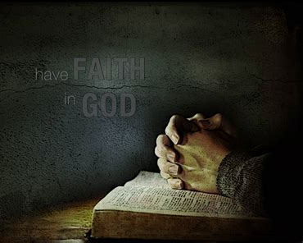
Explaining Israel's Sign: Romans 4:9-17
⁹ Cometh this blessedness then upon the circumcision only, or upon the uncircumcision also? for we say that faith was reckoned to Abraham for righteousness.

Slide 38
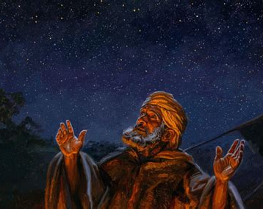
Explaining Israel's Sign: Romans 4:10-12
¹⁰ How was it then reckoned? when he was in circumcision, or in uncircumcision? Not in circumcision, but in uncircumcision.

Slide 39
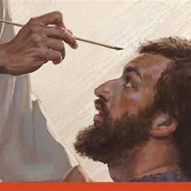
Explaining Israel's Sign: Romans 4:11-12
¹¹ And he received the sign of circumcision, a seal of the righteousness of the faith which he had yet being uncircumcised: that he might be the father of all them that believe, though they be not circumcised; that righteousness might be imputed unto them also:

Slide 40
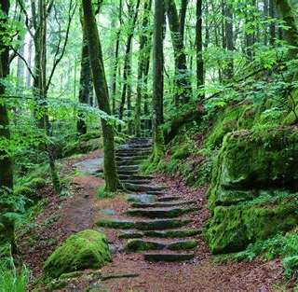
Explaining Israel's Sign: Romans 4:12
¹² And the father of circumcision to them who are not of the circumcision only, but who also walk in the steps of that faith of our father Abraham, which he had being yet uncircumcised.

Slide 41
But the Jewish sign of dedication to God was passed over in favor of a new symbol!
Paul tells us clearly that circumcision was a seal for Abraham, “a seal of the righteousness of the faith which he had” before his circumcision. The seal isn’t Abraham’s faith itself, but a marker, sign, or token that his faith existed. It was evidence that Abraham trusted in God (righteousness by faith) above his own flesh (righteousness by works).

Slide 42
The Seal of Baptism
In the New Testament, circumcision is set aside as the sign of the covenant, as a sign of righteousness by faith, and in its place is the sign of baptism. The idea of cutting off a person’s inclinations to make room for God’s plans hadn’t changed though! The symbolism just expanded slightly.
Instead of symbolically cutting the flesh, baptism symbolically cuts off a person’s life—at least, as it is currently being lived. It’s replaced, not with just an altered body, but with an altered way of living.

Slide 43
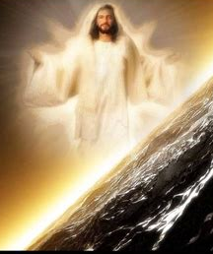
Spiritual Israel's Sign: Ephesians 1:9-14
⁹ Having made known unto us the mystery of his will, according to his good pleasure which he hath purposed in himself:
¹⁰ That in the dispensation of the fulness of times he might gather together in one all things in Christ, both which are in heaven, and which are on earth; even in him:

Slide 44
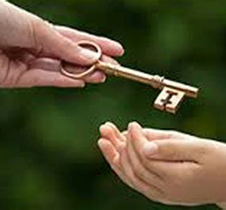
Spiritual Israel's Sign: Ephesians 1:11-14
¹¹ In whom also we have obtained an inheritance, being predestinated according to the purpose of him who worketh all things after the counsel of his own will:
¹² That we should be to the praise of his glory, who first trusted in Christ.

Slide 45
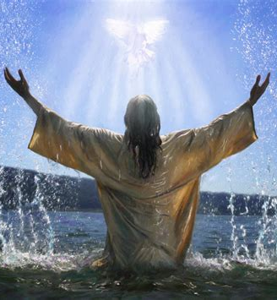
Spiritual Israel's Sign: Ephesians 1:13-14
¹³ In whom ye also trusted, after that ye heard the word of truth, the gospel of your salvation: in whom also after that ye believed, ye were sealed with that holy Spirit of promise,
¹⁴ Which is the earnest of our inheritance until the redemption of the purchased possession, unto the praise of his glory.

Slide 46
Notice how the seal of baptism always seems to be mentioned in connection with abandoning sin and self. This is the same circumcision of the heart that Deuteronomy mentioned.
Paul describes a sealing (baptism) in connection with conversion and reception of the gift of the Holy Spirit. He calls this gift a “deposit” or “down payment” given to all believers as an assurance of the complete redemption and future inheritance they will receive when Jesus comes.

Slide 47
The seal of God is a sign of God’s ownership and protection of His people.
It recognizes that they have chosen HIM above all else.
The book of Revelation pictures another sealing just prior to the second advent. It is contrasted to a mark placed on certain people in that same timeframe.

Slide 48
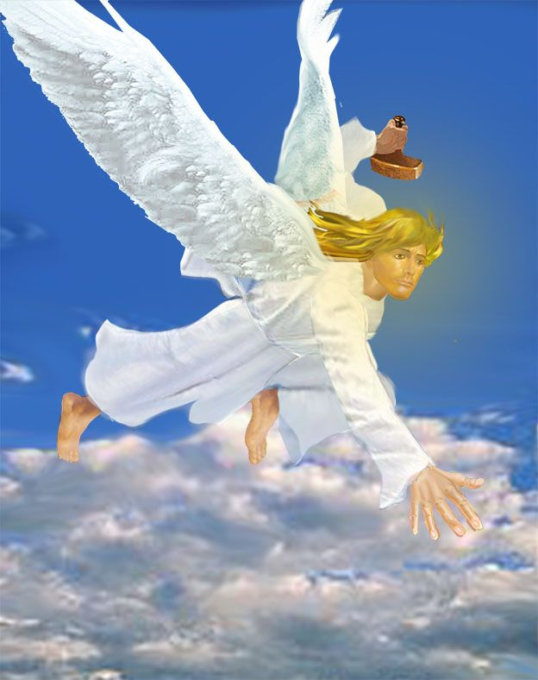
The Final Seal: Revelation 7:2-4
2 And I saw another angel ascending from the east, having the seal of the living God: and he cried with a loud voice to the four angels, to whom it was given to hurt the earth and the sea,

Slide 49
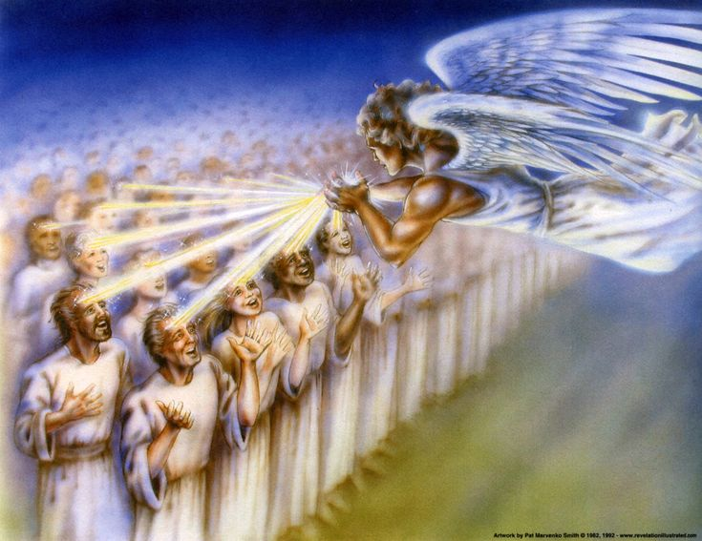
The Final Seal: Revelation 7:3-4
3 Saying, Hurt not the earth, neither the sea, nor the trees, till we have sealed the servants of our God in their foreheads.

Slide 50
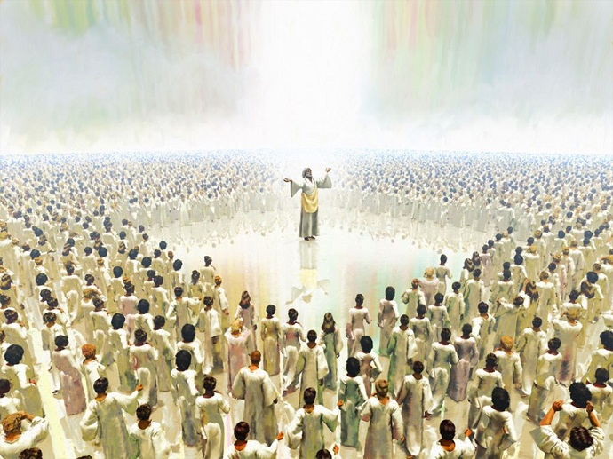
The Final Seal: Revelation 7:4
4 And I heard the number of them which were sealed: and there were sealed an hundred and forty and four thousand of all the tribes of the children of Israel.

Slide 51
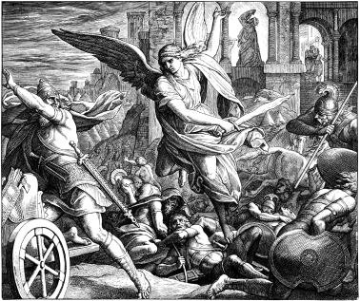
Old Testament Echoes: Ezekiel 9:1-6
9 He cried also in mine ears with a loud voice, saying, Cause them that have charge over the city to draw near, even every man with his destroying weapon in his hand.

Slide 52
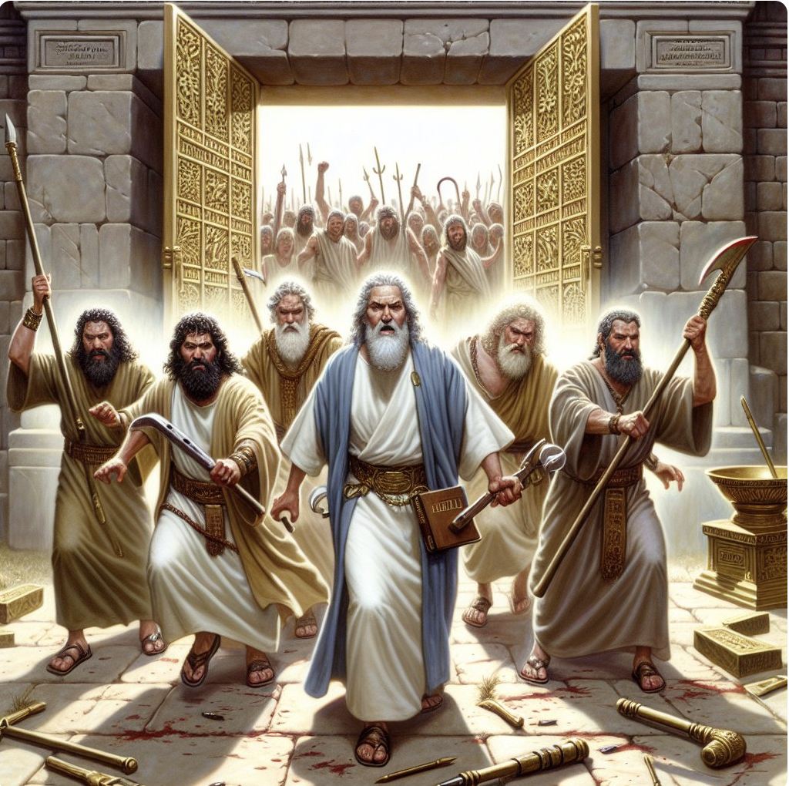
Old Testament Echoes: Ezekiel 9:2-6
2 And, behold, six men came from the way of the higher gate, which lieth toward the north, and every man a slaughter weapon in his hand; and one man among them was clothed with linen, with a writer's inkhorn by his side: and they went in, and stood beside the brasen altar.

Slide 53
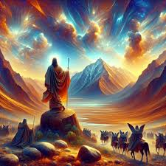
Old Testament Echoes: Ezekiel 9:3-6
3 And the glory of the God of Israel was gone up from the cherub, whereupon he was, to the threshold of the house. And he called to the man clothed with linen, which had the writer's inkhorn by his side;

Slide 54
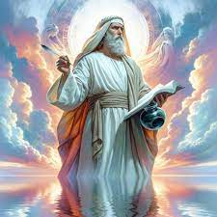
Old Testament Echoes: Ezekiel 9:4-6
4 And the Lord said unto him, Go through the midst of the city, through the midst of Jerusalem, and set a mark upon the foreheads of the men that sigh and that cry for all the abominations that be done in the midst thereof.

Slide 55
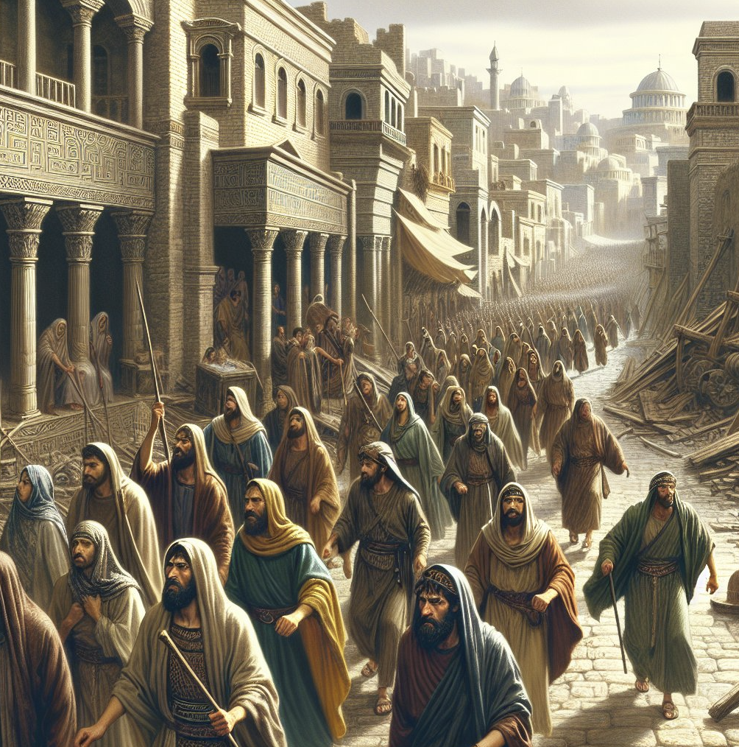
Old Testament Echoes: Ezekiel 9:5-6
5 And to the others he said in mine hearing, Go ye after him through the city, and smite: let not your eye spare, neither have ye pity:

Slide 56
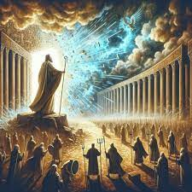
Old Testament Echoes: Ezekiel 9:6
6 Slay utterly old and young, both maids, and little children, and women: but come not near any man upon whom is the mark; and begin at my sanctuary. Then they began at the ancient men which were before the house.

Slide 57
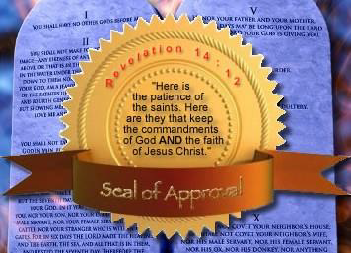
The Seal of God: Revelation 14:1-5
14 And I looked, and, lo, a Lamb stood on the mount Sion, and with him an hundred forty and four thousand, having his Father's name written in their foreheads.

Slide 58
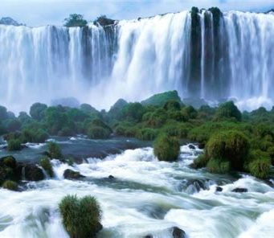
The Seal of God: Revelation 14:2-5
² And I heard a voice from heaven, as the voice of many waters, and as the voice of a great thunder: and I heard the voice of harpers harping with their harps:

Slide 59
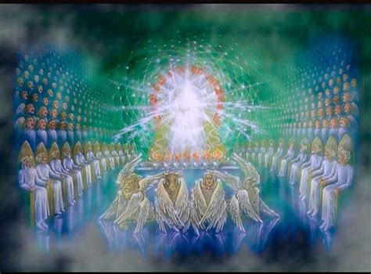
The Seal of God: Revelation 14:3-5
³ And they sung as it were a new song before the throne, and before the four beasts, and the elders: and no man could learn that song but the hundred and forty and four thousand, which were redeemed from the earth.

Slide 60
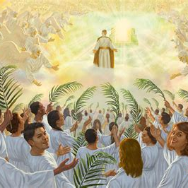
The Seal of God: Revelation 14:4-5
⁴ These are they which were not defiled with women; for they are virgins. These are they which follow the Lamb whithersoever he goeth. These were redeemed from among men, being the firstfruits unto God and to the Lamb.

Slide 61
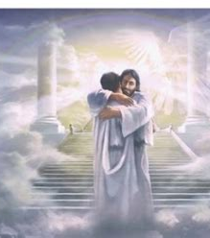
The Seal of God: Revelation 14:5
⁵ And in their mouth was found no guile: for they are without fault before the throne of God.

Slide 62
This final seal is given to the 144,000 At the end of time. They have God’s name (or signature) written in their foreheads.
Through the Holy Spirit’s work in their lives they have come to reflect God’s character.

Slide 63
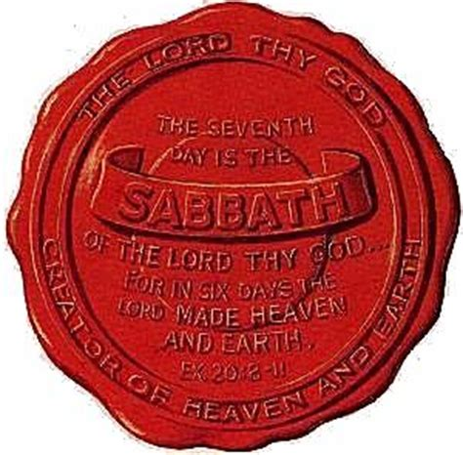
The Seal of God: Exodus 31:12-17
¹² And the Lord spake unto Moses, saying,
¹³ Speak thou also unto the children of Israel, saying, Verily my sabbaths ye shall keep: for it is a sign between me and you throughout your generations; that ye may know that I am the Lord that doth sanctify you.

Slide 64
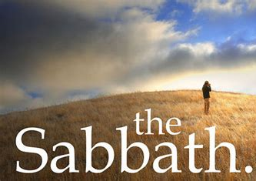
The Seal of God: Exodus 31:14-17
¹⁴ Ye shall keep the sabbath therefore; for it is holy unto you: every one that defileth it shall surely be put to death: for whosoever doeth any work therein, that soul shall be cut off from among his people.

Slide 65
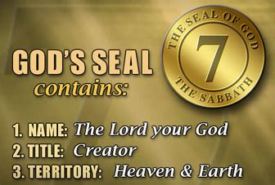
The Seal of God: Exodus 31:15-17
¹⁵ Six days may work be done; but in the seventh is the sabbath of rest, holy to the Lord: whosoever doeth any work in the sabbath day, he shall surely be put to death.

Slide 66
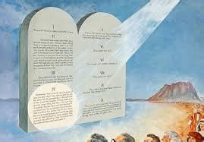
The Seal of God: Exodus 31:16-17
¹⁶ Wherefore the children of Israel shall keep the sabbath, to observe the sabbath throughout their generations, for a perpetual covenant.

Slide 67

The Seal of God: Exodus 31:17
¹⁷ It is a sign between me and the children of Israel for ever: for in six days the Lord made heaven and earth, and on the seventh day he rested, and was refreshed.

Slide 68

The Seal of God: Ezekiel 20:11-12
¹¹ And I gave them my statutes, and shewed them my judgments, which if a man do, he shall even live in them.
¹² Moreover also I gave them my sabbaths, to be a sign between me and them, that they might know that I am the Lord that sanctify them.

Slide 69

The Seal of God: Hebrews 4:4-11
⁴ For he spake in a certain place of the seventh day on this wise, And God did rest the seventh day from all his works.
⁵ And in this place again, If they shall enter into my rest.

Slide 70

The Seal of God: Hebrews 4:6-11
⁶ Seeing therefore it remaineth that some must enter therein, and they to whom it was first preached entered not in because of unbelief:
⁷ Again, he limiteth a certain day, saying in David, To day, after so long a time; as it is said, To day if ye will hear his voice, harden not your hearts.

Slide 71

The Seal of God: Hebrews 4:8-11
⁸ For if Jesus had given them rest, then would he not afterward have spoken of another day.
⁹ There remaineth therefore a rest to the people of God.

Slide 72

The Seal of God: Hebrews 4:10-11
¹⁰ For he that is entered into his rest, he also hath ceased from his own works, as God did from his.
¹¹ Let us labour therefore to enter into that rest, lest any man fall after the same example of unbelief.

Slide 73
The symbol, mark, of God’s authority and power is His holy Sabbath day. When we enter God’s rest (receive salvation), we should keep His seventh-day Sabbath holy as a symbol, or mark, of salvation.
True Sabbath keeping signifies that a person has surrendered his life to Jesus Christ and is willing to follow wherever Jesus leads.

Slide 74

A Sabbath Promise: Isaiah 58:1, 13-14
58 Cry aloud, spare not, lift up thy voice like a trumpet, and shew my people their transgression, and the house of Jacob their sins.

Slide 75

A Sabbath Promise: Isaiah 58:1, 13-14
¹³ If thou turn away thy foot from the sabbath, from doing thy pleasure on my holy day; and call the sabbath a delight, the holy of the Lord, honourable; and shalt honour him, not doing thine own ways, nor finding thine own pleasure, nor speaking thine own words:

Slide 76

A Sabbath Promise: Isaiah 58:1, 13-14
¹⁴ Then shalt thou delight thyself in the Lord; and I will cause thee to ride upon the high places of the earth, and feed thee with the heritage of Jacob thy father: for the mouth of the Lord hath spoken it.

Slide 77

An End-Time Appeal: Revelation 3:14-22
¹⁴ And unto the angel of the church of the Laodiceans write; These things saith the Amen, the faithful and true witness, the beginning of the creation of God;
¹⁵ I know thy works, that thou art neither cold nor hot: I would thou wert cold or hot.

Slide 78

An End-Time Appeal: Revelation 3:16-22
¹⁶ So then because thou art lukewarm, and neither cold nor hot, I will spue thee out of my mouth.
¹⁷ Because thou sayest, I am rich, and increased with goods, and have need of nothing; and knowest not that thou art wretched, and miserable, and poor, and blind, and naked:

Slide 79

An End-Time Appeal: Revelation 3:18-22
¹⁸ I counsel thee to buy of me gold tried in the fire, that thou mayest be rich; and white raiment, that thou mayest be clothed, and that the shame of thy nakedness do not appear; and anoint thine eyes with eyesalve, that thou mayest see.

Slide 80

An End-Time Appeal: Revelation 3:19-22
¹⁹ As many as I love, I rebuke and chasten: be zealous therefore, and repent.
²⁰ Behold, I stand at the door, and knock: if any man hear my voice, and open the door, I will come in to him, and will sup with him, and he with me.

Slide 81

An End-Time Appeal: Revelation 3:21-22
²¹ To him that overcometh will I grant to sit with me in my throne, even as I also overcame, and am set down with my Father in his throne.
²² He that hath an ear, let him hear what the Spirit saith unto the churches.

Slide 82
The message to the Church of Laodicea is an appeal to all of us! It pleads with us to make a choice. Any choice, apparently, is better than apathy. And this appeal comes from (among other titles) the “beginning of the Creation of God.”
It’s an appeal from our Creator, just as we’ve seen in Revelation 14!

Slide 83
A storm is coming, relentless in its fury. Are we prepared to meet it?
Testimonies for the Church, vol, 8, p. 315
Ellen G. White

Slide 84
THANK YOU!
And Happy SABBATH!

